Slide 1
Post Seismic Bridge Inspection
Abutment Approach

Slide 2
10 Steps of Assessment
Check Approaches
Check Rails
Check Expansion Joints
Check Wingwalls
Check Abutments
Check Bearings
Check Girders
Check Soffit and Deck
Check Bents or Columns
Check Caps

Slide 3
First, Second and Third Parts Approaches, Rails and Expansion Joints
Check Approaches
Check Rails
Check Expansion Joints
Check Wingwalls
Check Abutments
Check Bearings
Check Girders
Check Soffit and Deck
Check Bents or Columns
Check Caps

Slide 4
Safety First Approaching the Bridge
You have to stop at the bridge anyway so… inspect the bridge BEFORE you drive across.
In fact, stop at least 30’ before the bridge in case there is an approach slab with a problem.

Slide 5
1. Beginning at the Approach
X
1.
1. Park 30’ before the bridge, look at the approach – is it raised or lowered? Any voids?

Slide 6
1. Approach Slab Settlement
1” to 6” Settlement
> 6” Settlement

Slide 7
1. Approach Slab Settlement
> 6” Settlement
Impassible

Slide 8
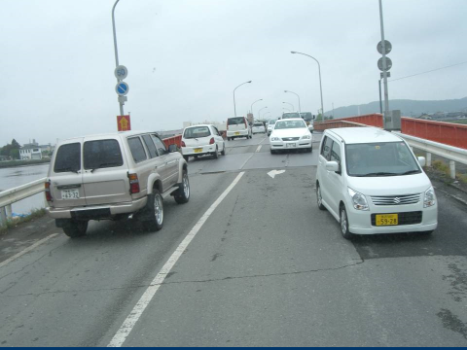
Rapid Repair to Settlement at Approach Temporary Steel Plates

Slide 9
2. & 3. Rail and Curb Alignment, Joint at Curb Lines
X
1.
2.
3.
2. Sight down the rails for alignment or visible damage.

Slide 10
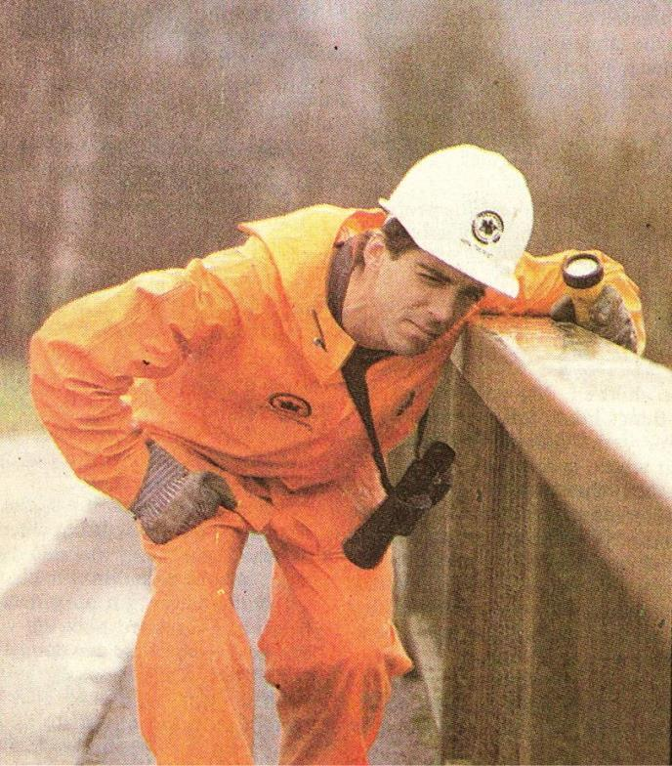
2. & 3. Taking the First Look at the Bridge
Hmm…looks straight
Sight down the rail lines
Straight

Slide 11
2. & 3. Railing and Curb
Bending but no separation or spalling

Slide 12
2. & 3. Railing and Joint at Curb Line
No Separation in Rail,
but Settlement in Barrier
and Joint
Local Damage to Barrier, but not Rail
Call to have debris removed
Notes:
Rapid safety assessment – You are not there to do maintenance or debris removal. Call in for debris removal or set up cones, but keep on moving to the next assessment and next bridge.

Slide 13
10 Steps of Assessment
Check Approaches
Check Rails
Check Expansion Joints
Check Wingwalls
Check Abutments
Check Bearings
Check Girders
Check Soffit and Deck
Check Bents or Columns
Check Caps

Slide 14
Fourth and Fifth Parts Wingwalls and Abutments
Check Approaches
Check Rails
Check Expansion Joints
Check Wingwalls
Check Abutments
Check Bearings
Check Girders
Check Soffit and Deck
Check Bents or Columns
Check Bent Caps

Slide 15
4. Wingwalls
X
1.
2.
3.
4.
4. Wingwalls – look for cracks, broken concrete and evidence of movement at the ground line.

Slide 16
Minor Damage:
Shear Cracking
Moderate Damage:
Rotation and Separation

Slide 17
5. Abutment
X
2.
1.
Abutments
Transverse movement may displace or crack the cheek-walls, wing-walls (Figures 5-45, 5-46) and any abutment shear blocks. Longitudinal movement during an earthquake may damage the abutment stem and/or backwall (Figure 5-47). Examine abutment backwall and wing-walls for flexural or shear cracks, which may be less obvious than abutment movement. Loose or settled fill, slope failures, liquefaction, fissures and differential settlements at the base of the abutments may be observed as evidence of foundation movement and possible damage. If any evidence of cracking or displacement is observed, be sure to note it on the form and specify the location in the ‘Comments’ field.
3.
2.
4.
5.
5. Abutment – look for cracks, broken concrete and areas of movement at the ground line.

Slide 18
5. Abutment Damages
Cracks, but
No Separation
Abutments
Transverse movement may displace or crack the cheek-walls, wing-walls (Figures 5-45, 5-46) and any abutment shear blocks. Longitudinal movement during an earthquake may damage the abutment stem and/or backwall (Figure 5-47). Examine abutment backwall and wing-walls for flexural or shear cracks, which may be less obvious than abutment movement. Loose or settled fill, slope failures, liquefaction, fissures and differential settlements at the base of the abutments may be observed as evidence of foundation movement and possible damage. If any evidence of cracking or displacement is observed, be sure to note it on the form and specify the location in the ‘Comments’ field.
Figure 5-47. Moderate Damage: Spalling and Cracking of Abutment, Movement at Ground Level (MO) Note that the rebar is not rusting, an indication that damage is recent.
Large cracks spalling,
but still supporting and
no separation

Slide 19
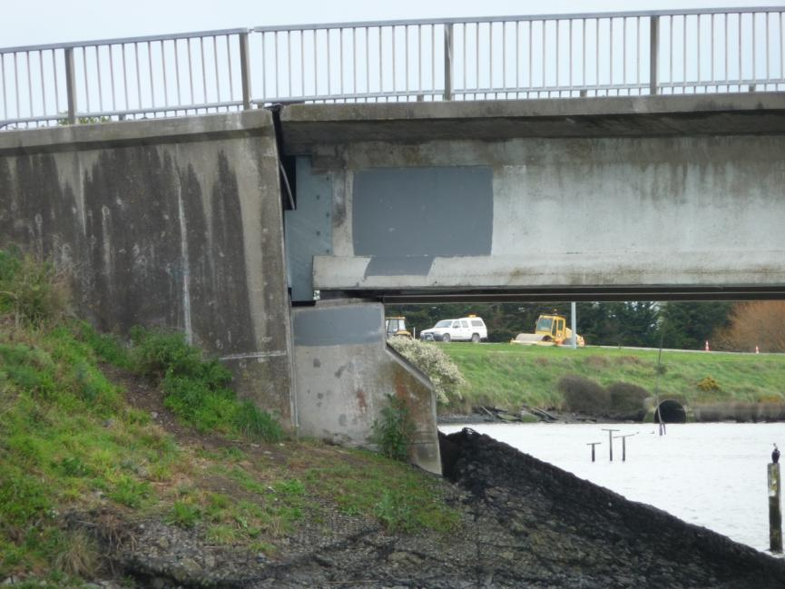
5. Abutment Damages (cont’d)
Abutment Rotation
about 15 Degrees
Notes:
Drivable, but restricted use.
Reduced speed.

Slide 20
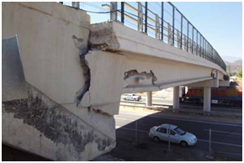
5. Abutment damages (cont’d)
Heavy shear failure of shear block and
separation from superstructure more than 6”
Notes:
Do not park under bridge!

Slide 21
Exercise
Fill out assessment forms for the last bridge.

Slide 22
STATE OF CALIFORNIA
SAFETY ASSESSMENT PROGRAM
BRIDGE
Assessment Report No. _________

Slide 23
Assessment Report # _________

Slide 24
Assessment Report # _____________

Slide 25
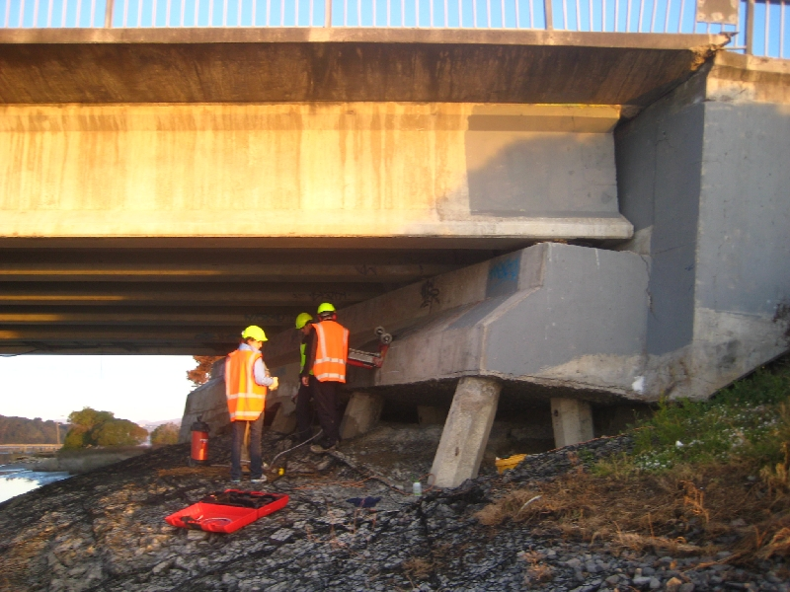
5. Abutment Damages (cont’d)
Pile Foundation Rotation
more than 6”
Notes:
displaced more than 6" laterally or vertically.
Piles sheared off below ground, or uplift failure.
Lateral spread failure.

