Slide 1
Post Seismic Bridge Inspection
Check Bearings

Slide 2
10 Steps of Assessment
Check Approaches
Check Rails
Check Expansion Joints
Check Wingwalls
Check Abutments
Check Bearings
Check Girders
Check Soffit and Deck
Check Bents or Columns
Check Caps

Slide 3
Sixth Part
Bearings
Check Approaches
Check Rails
Check Expansion Joints
Check Wingwalls
Check Abutments
Check Bearings
Check Girders
Check Soffit and Deck
Check Bents or Columns
Check Caps

Slide 4
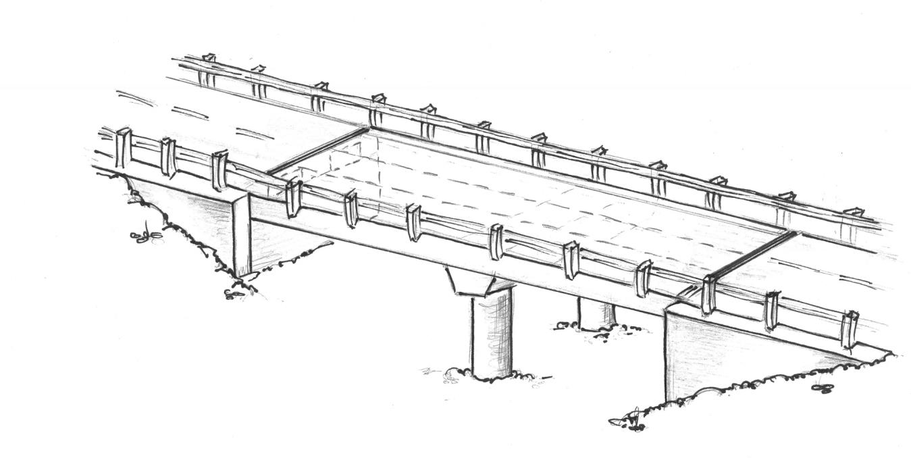
6. Bearings
2.
1.
2.
3.
4.
5.
6
.
6. Bearings – broken keeper bolts, tilted rockers, cracked concrete under bearing pads

Slide 5
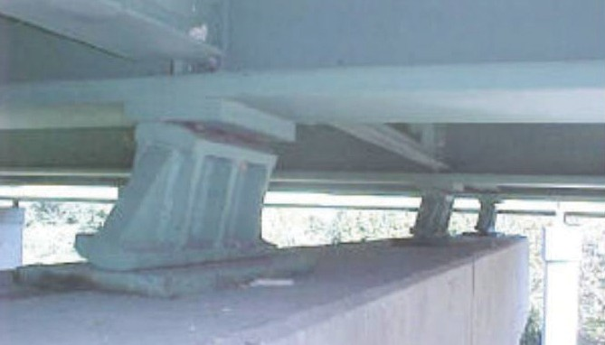
6. Bearings (cont’d)
Steel Rocker Bearings
Tilted Rocker Bearing

Slide 6
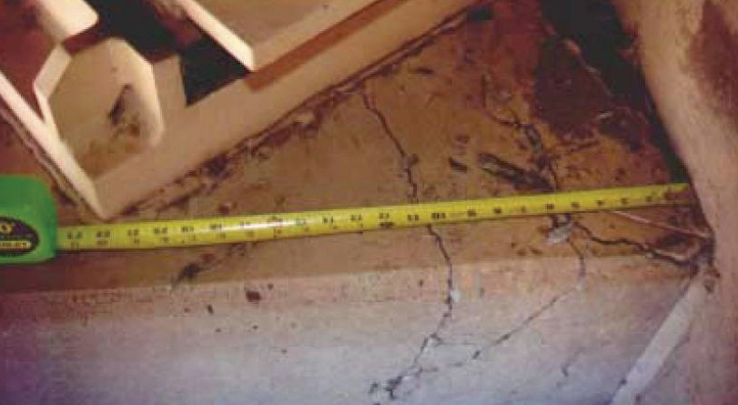
6. Bearings (cont’d)
Steel Bearings
Cracking under Masonry Plate

Slide 7
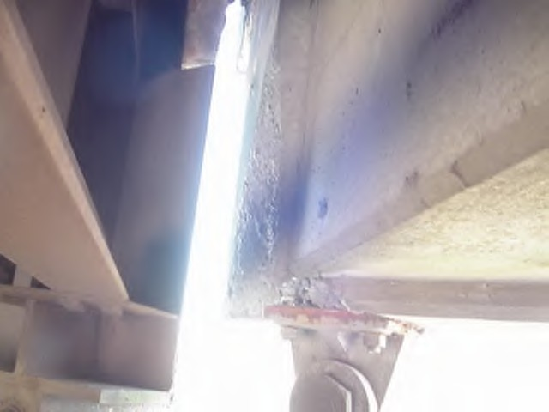
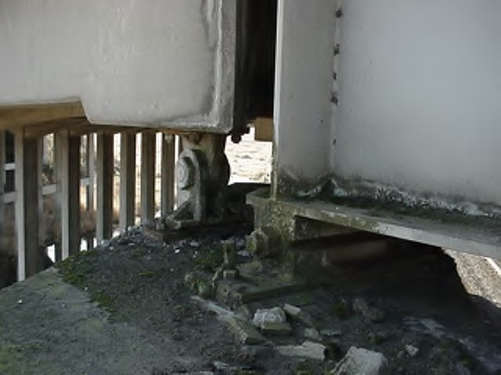
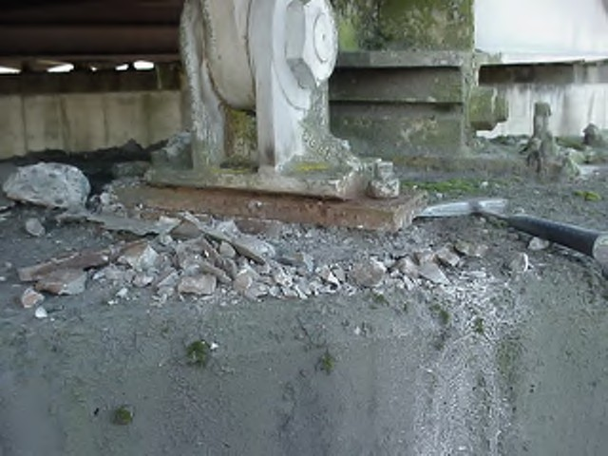
6. Bearings (cont’d)
Steel Pin Bearings
Minor Spalling of Concrete

Slide 8
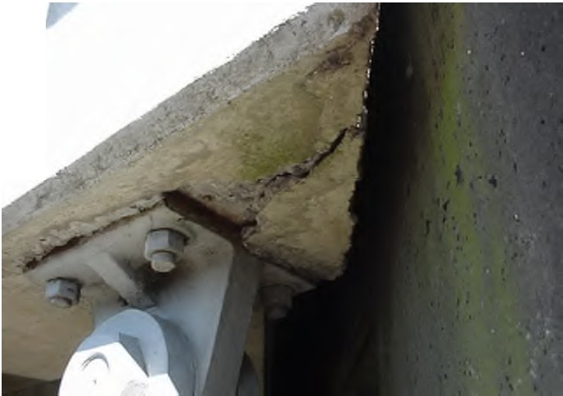
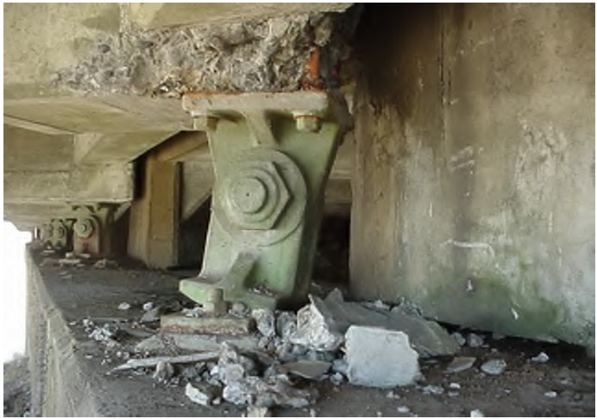
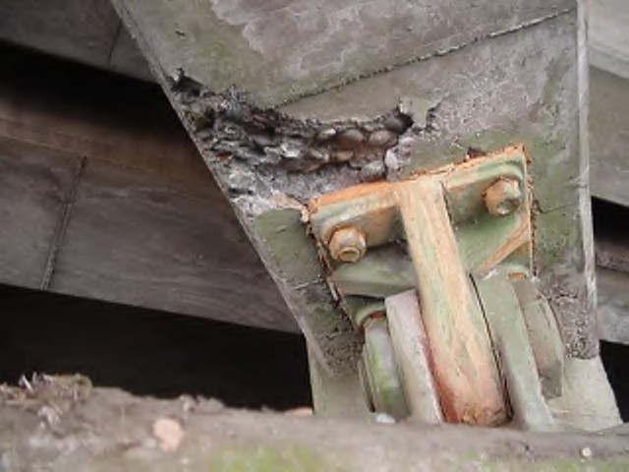
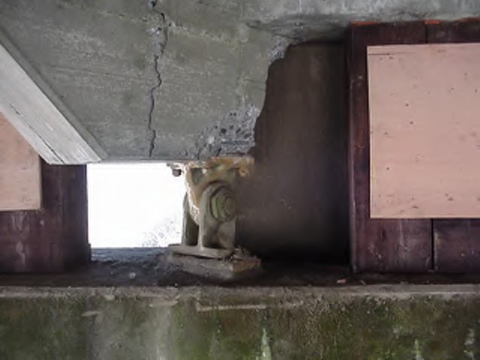
6. Bearings (cont’d)
Steel Pin Bearings
Moderate Girder Seat Cracking and Spalling

Slide 9
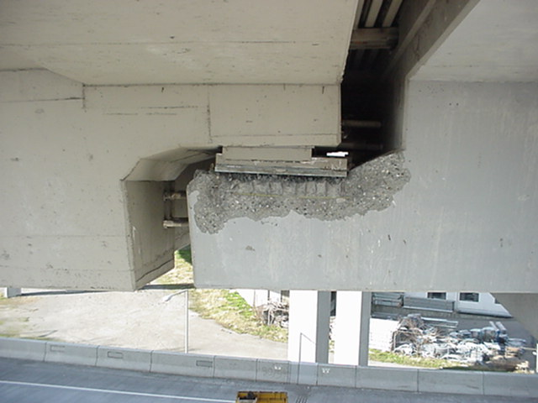
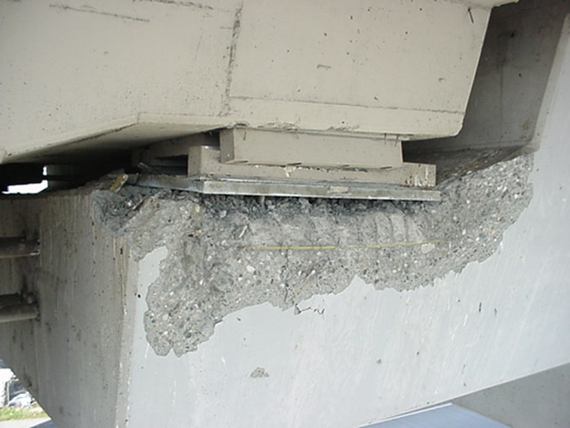
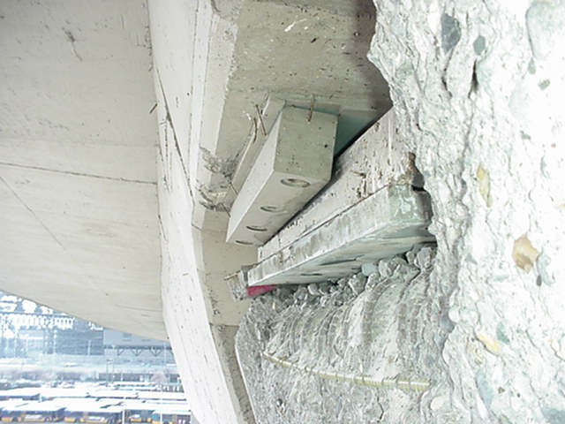
6. Bearings (cont’d)
Bearings at Hinge Seats
Significant Hinge Seat Edge Spalling / Hinge Still Sound

Slide 10
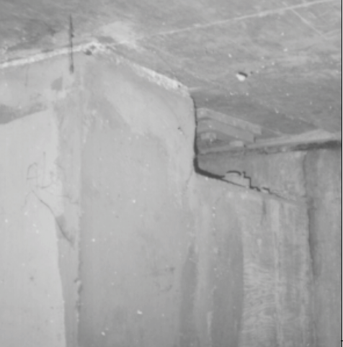
6. Bearings (cont’d)
Rocker Bearing
Missing/Toppled Bearing Rocker/Span on Blocks

Slide 11
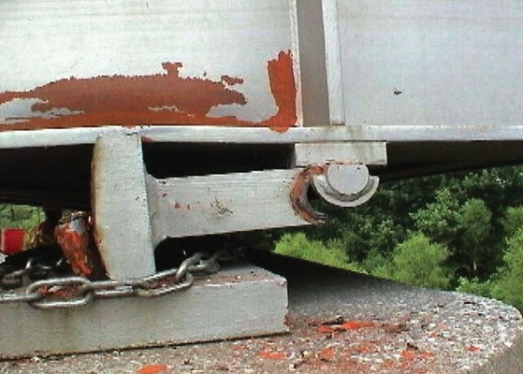
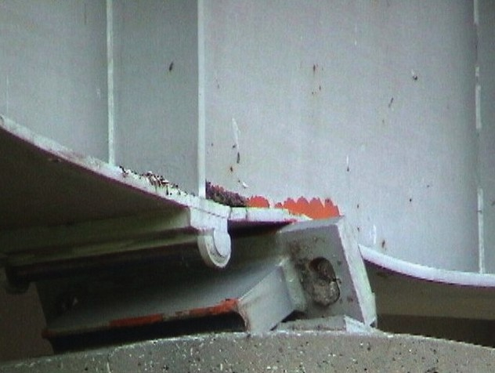
6. Bearings (cont’d)
Rocker Bearings
Failed Rocker Bearing / Damaged Bottom Flange

Slide 12
Exercise
Fill out forms for the last bridge

Slide 13
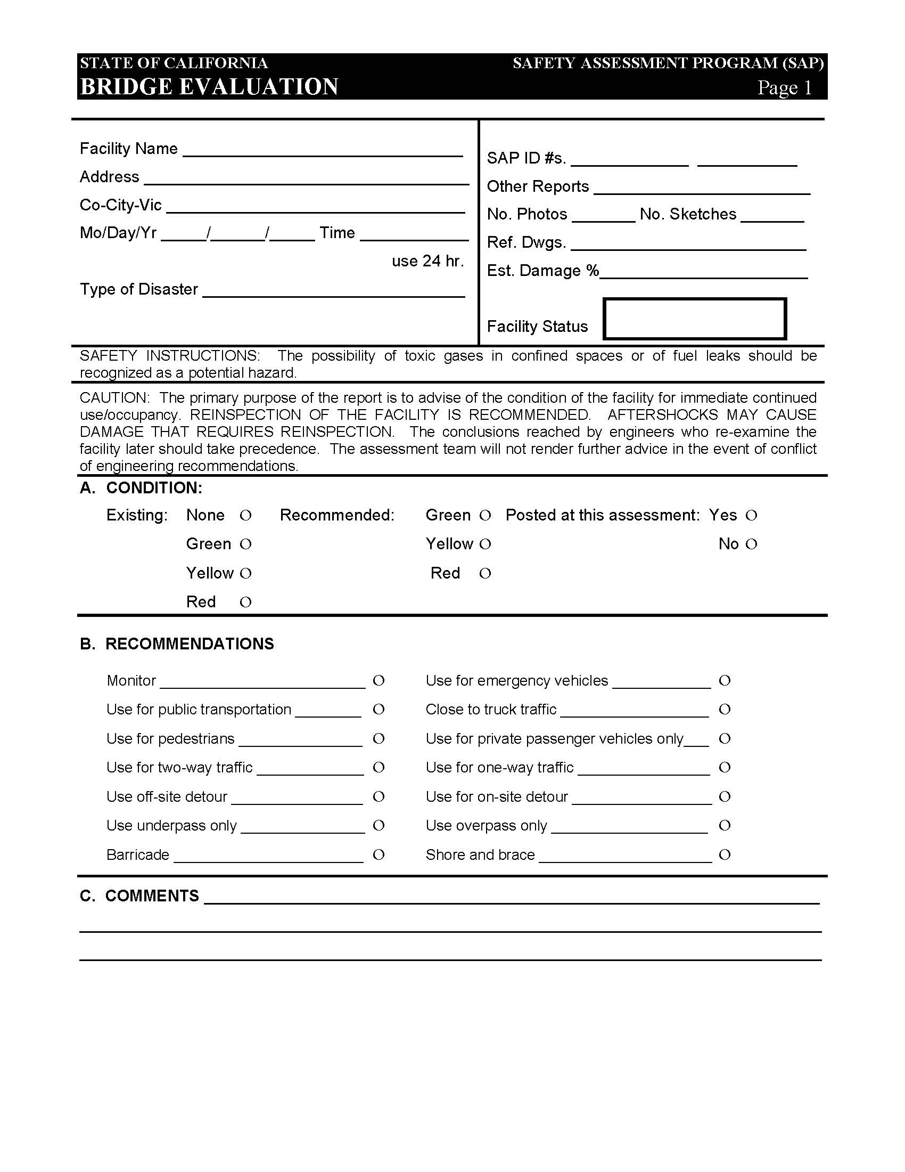
STATE OF CALIFORNIA
SAFETY ASSESSMENT PROGRAM
BRIDGE
Assessment Report No. _________

Slide 14
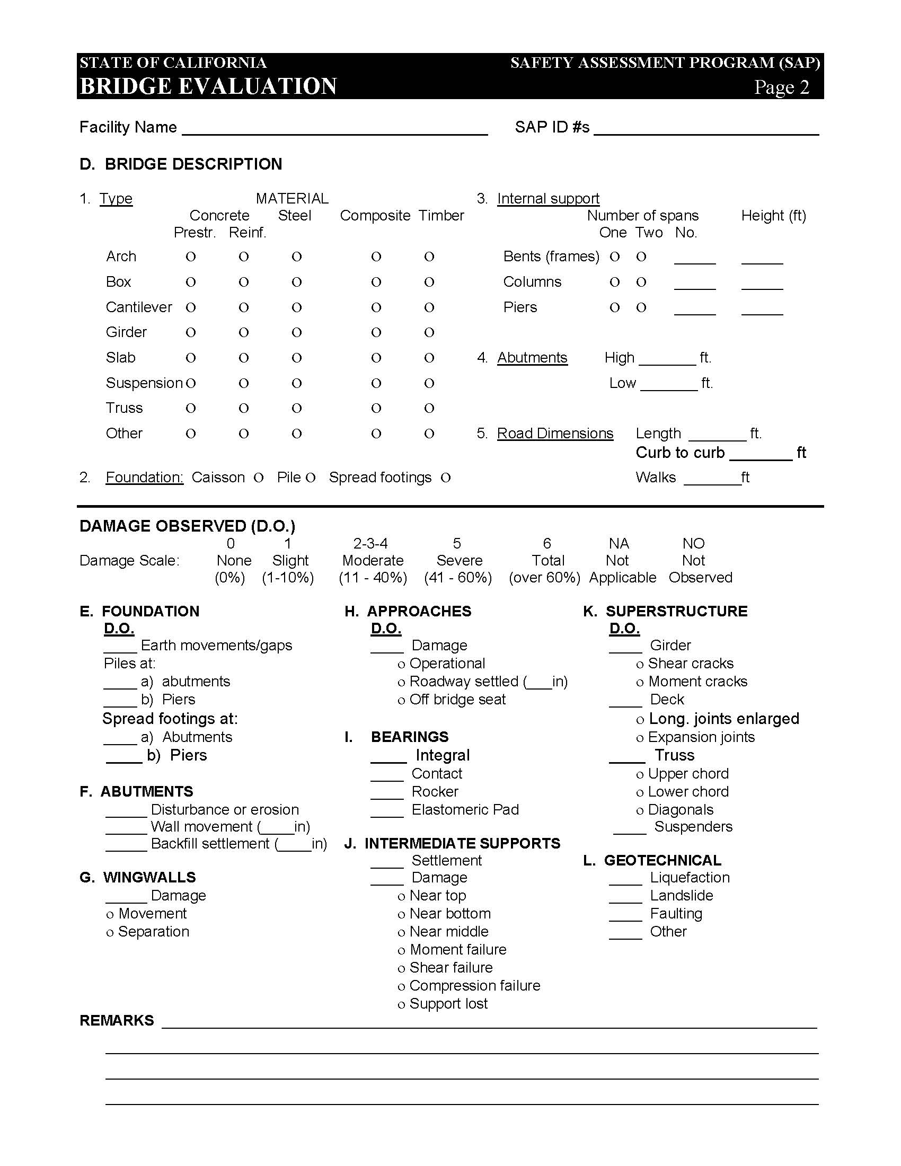
Assessment Report # _________

Slide 15
Assessment Report # _____________

Slide 16
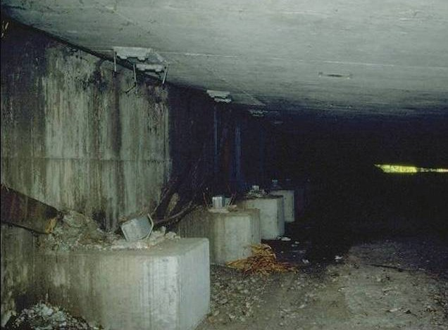
6. Bearings (cont’d)
All Bearings
Bearings Failed and Cannot Confirm Load Path

Slide 17
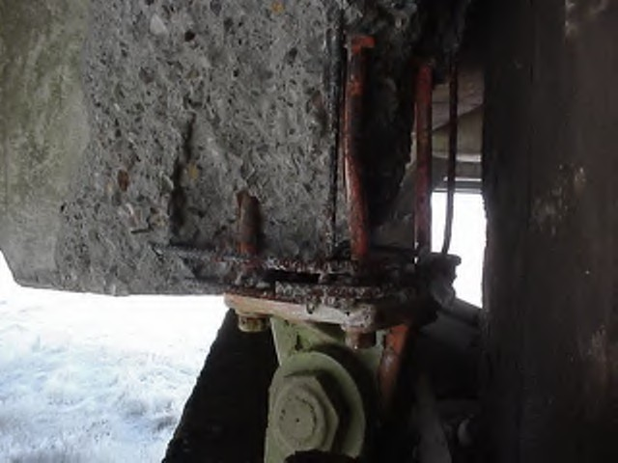
6. Bearings (cont’d)
Steel Pin Bearing and Others
Substantial Girder End Spalling above Bearing

Slide 18
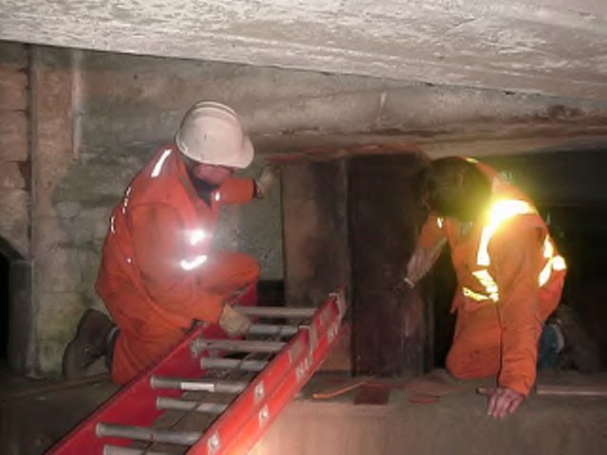
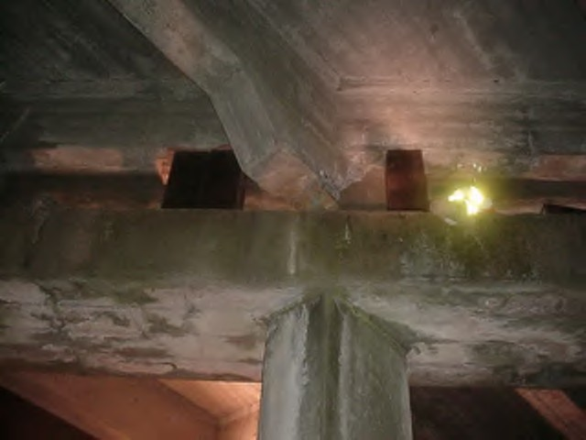
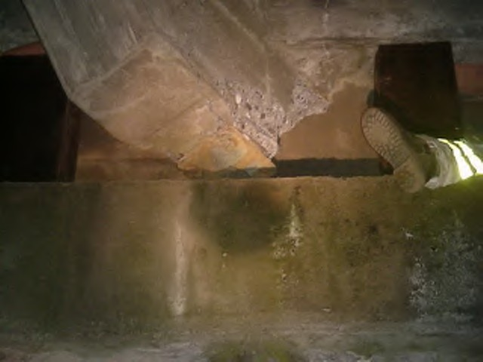
6. Bearings (cont’d)
Seat Loss
Girder End Spalling & Loss of Seat
Notes:
First photo is maintenance installing timber blocking to shore up span.
Second shows blocking in place.
Third is a closeup of the end of the girder.

