Slide 1
Post Seismic Bridge Inspection
Safety & Wrap-Up

Slide 2
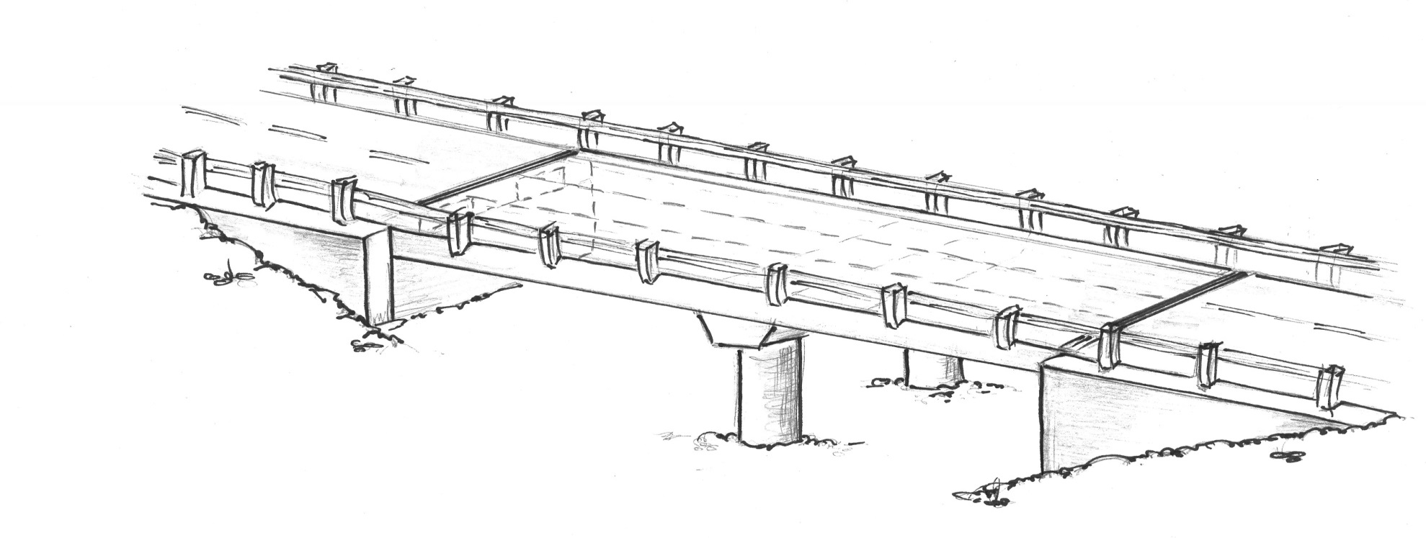
11. Finishing up
X
2.
1.
2.
3.
2.
4.
3.
5.
6.
2.
1.
7.
6.
10.
5.
4.
8.
11. Inspect same components on other end of bridge
9.

Slide 3
Assessment Forms
Complete the forms as you go
Carefully ID bridge name and location
Carefully document bridge parts
Make a sketch of bridge if you don’t have plans
Use standardized forms

Slide 4
Bridge Evaluations
Types of Damage:
  Support columns fail in shear
  Spans fall off abutments and piers
  Approaches settle, resulting in an offset at the abutment

Slide 5
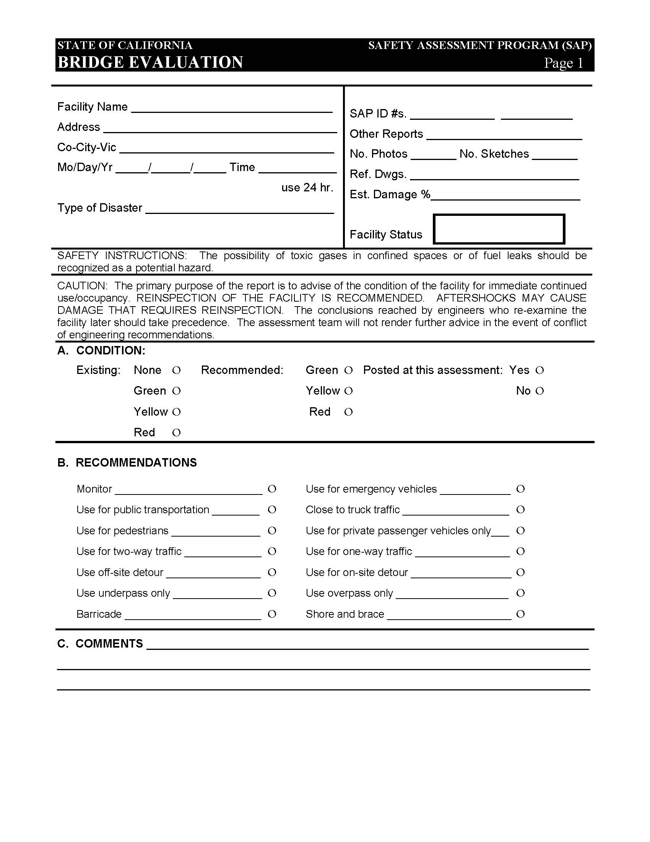
STATE OF CALIFORNIA
SAFETY ASSESSMENT PROGRAM
BRIDGE
Assessment Report No. _________

Slide 6
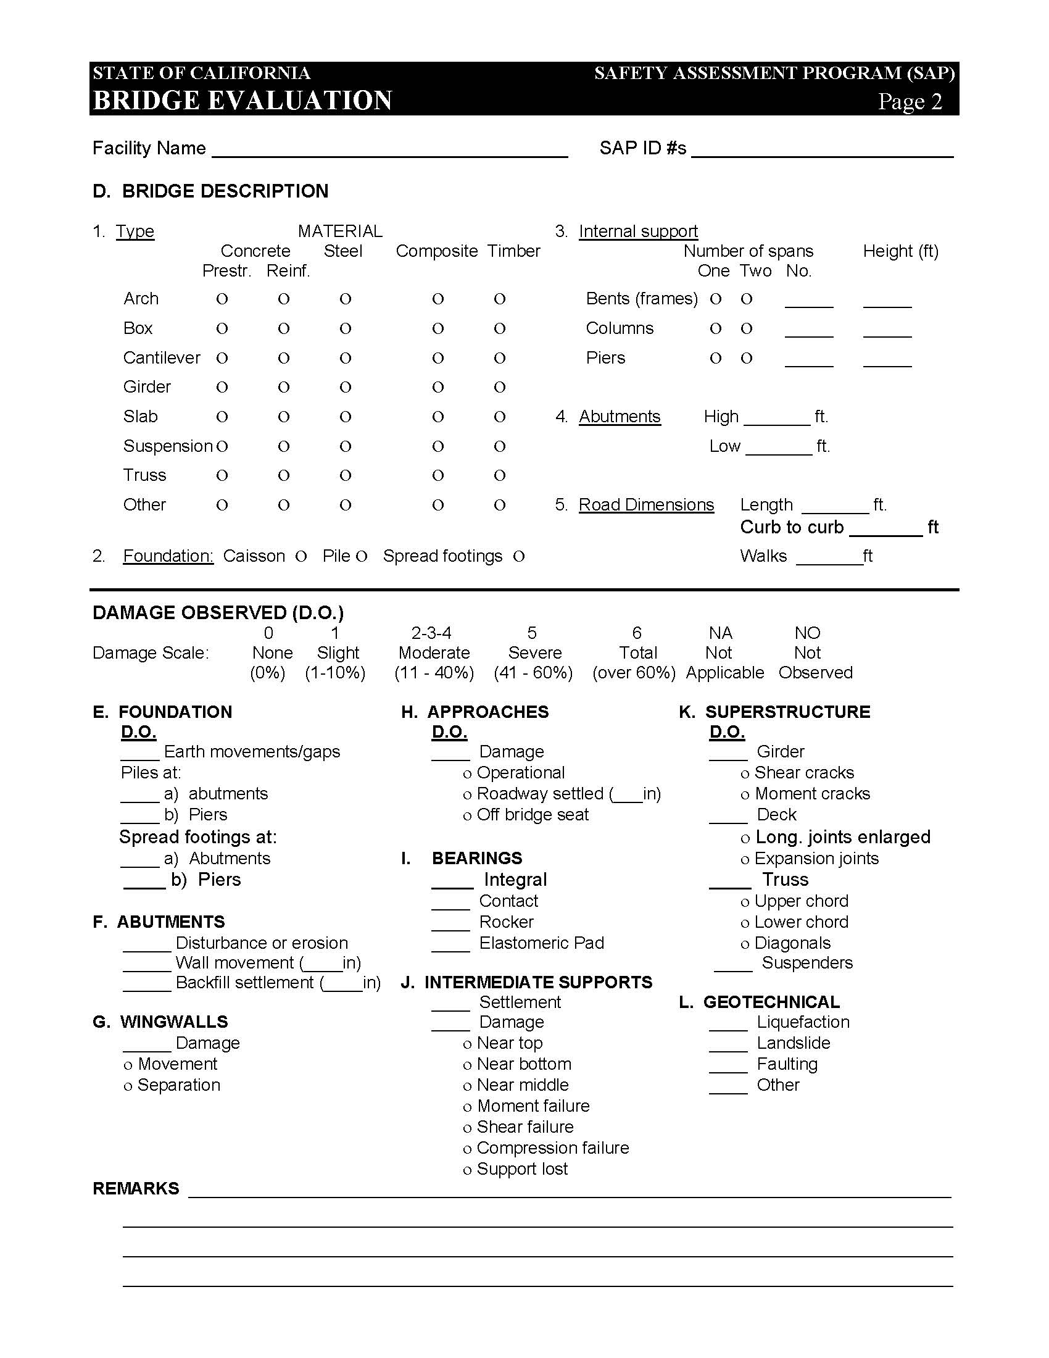
Assessment Report # _________

Slide 7
Assessment Report # _____________

Slide 8
Bridge Evaluations
Posting
If determined the bridge is UNSAFE, notify the jurisdiction immediately.

Slide 9
Field Safety

Slide 10
Hazardous Materials
Recognition
Type of facility
National Fire Protection Association Placards
Fumes, Odors, Visible Spills
Actions
Leave and post area
Notify jurisdiction or fire department

Slide 11
Common Failures Causing Hazmat Releases
Bridge structural failures
Underground pipeline breaks
Short connector pipe breaks
Equipment sliding or overturning
Downed Powerlines

Slide 12
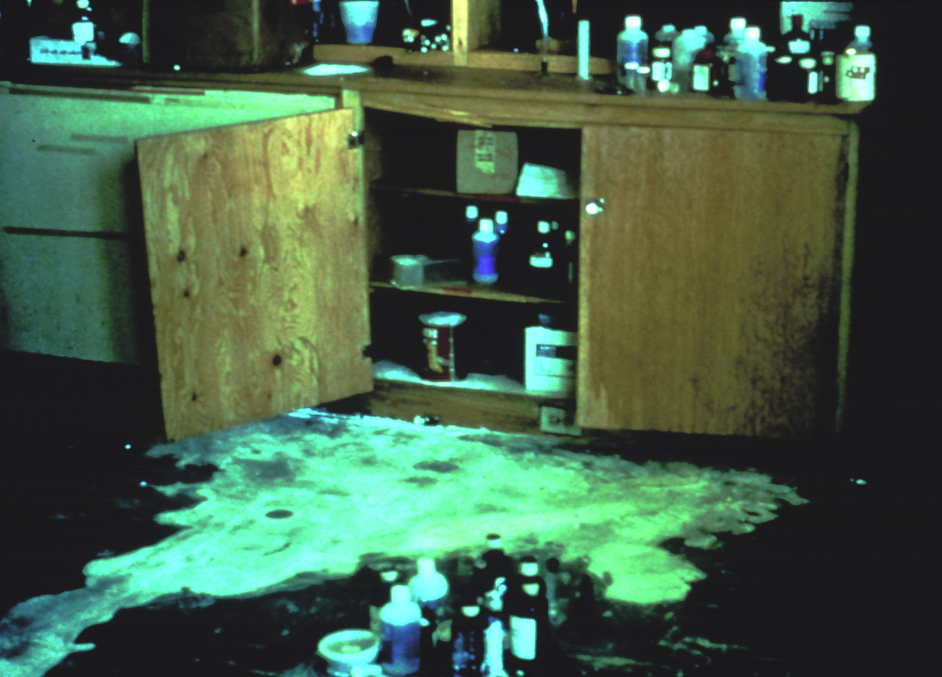

Slide 13
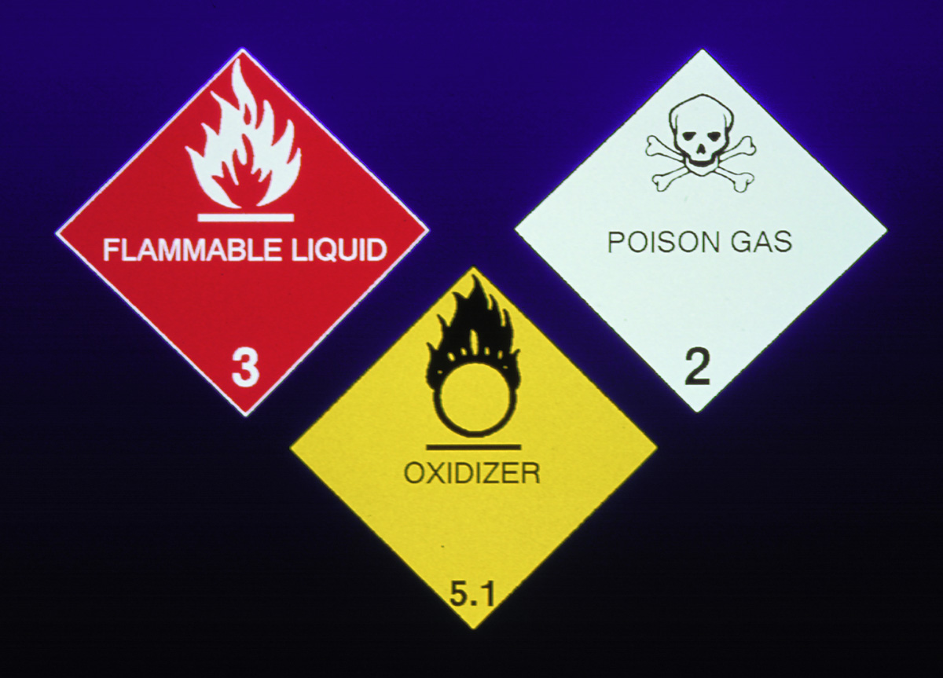

Slide 14
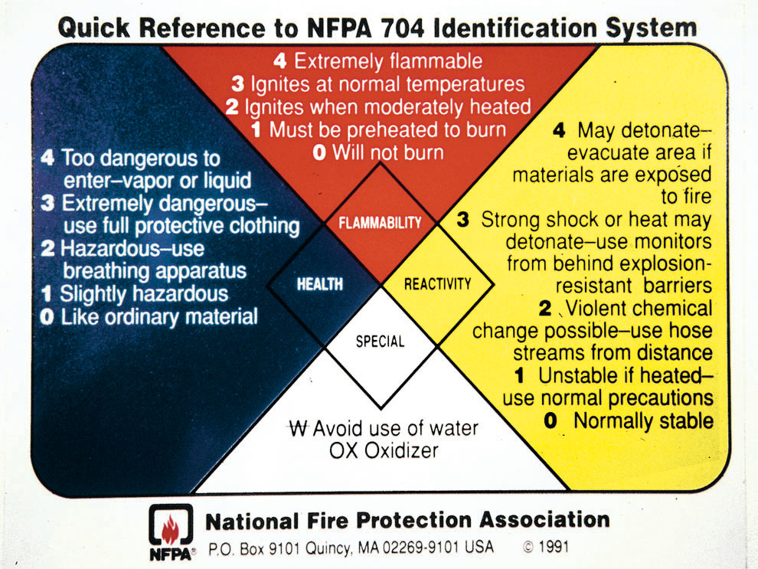
Notes:
This slide explains the standard National Fire Protection Association marking for areas in facilities where hazardous materials are stored. The actual sign is the diamond-shaped portion in the middle.
Note that it indicates by number and color code the health, fire, reactivity, and specific hazard for the material. The higher the number, up to four, the greater the danger for each hazard.

Slide 15
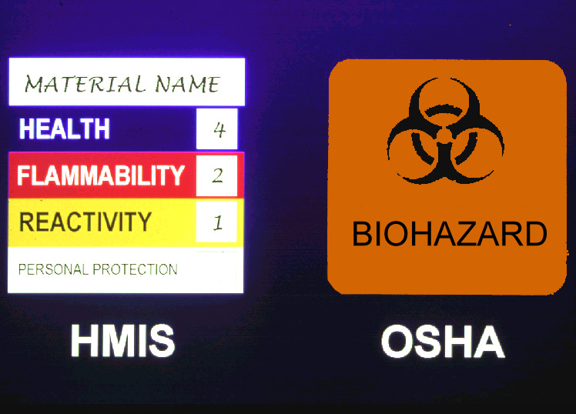


Slide 16
Field Safety
Travel in teams of two
Wear a hard hat, boots, safety goggles, high visibility safety vest and gloves
Survey bridge before approaching
Go next to or under only if safe
Avoid hazardous materials
  Sharps, broken glass, chemical spills

Slide 17
Field Safety (cont’d)
Be alert for falling objects
In case of fire, evacuate area
and alert fire department
Avoid downed power lines
Report gas leaks

Slide 18
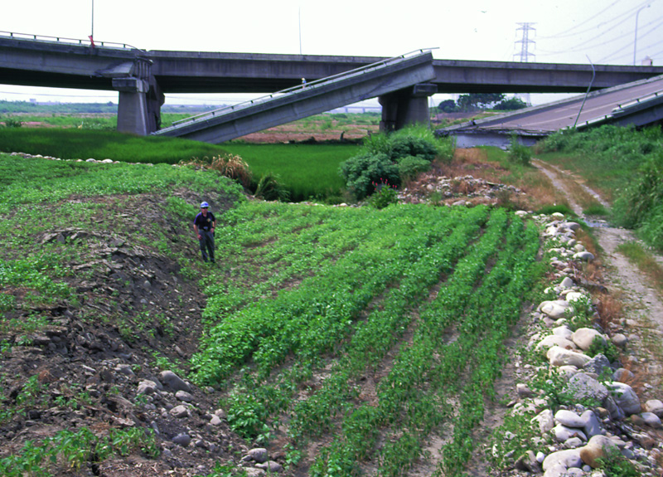
Photo: Dave Swanson

Slide 19
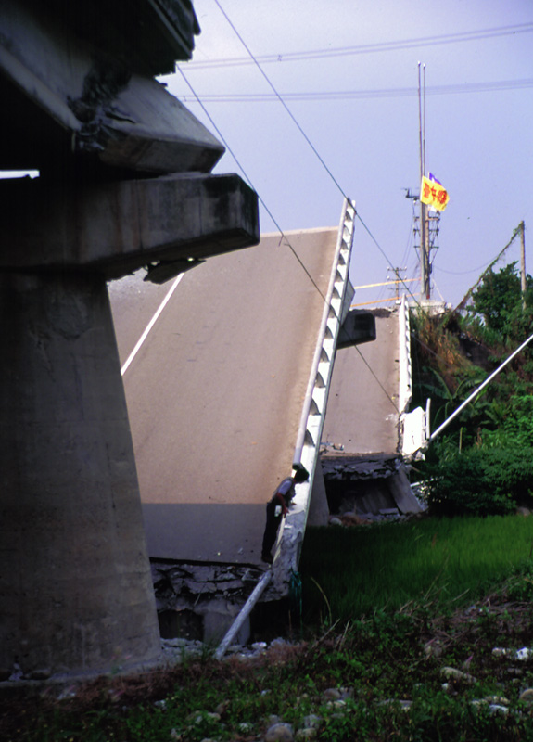
Photo: Dave Swanson

Slide 20
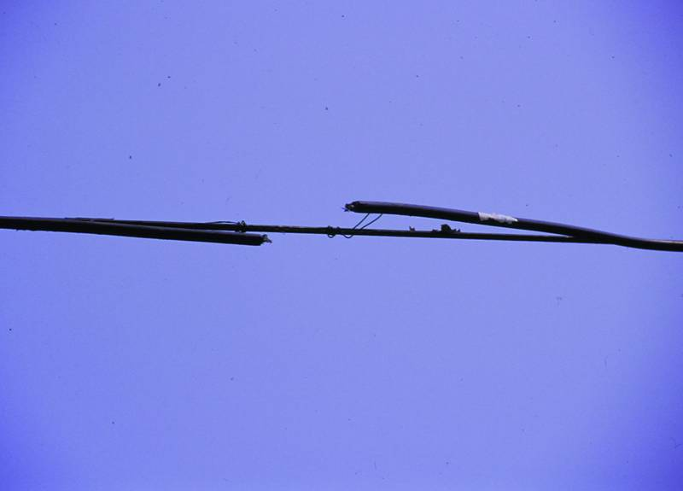
Photo: Dave Swanson

Slide 21
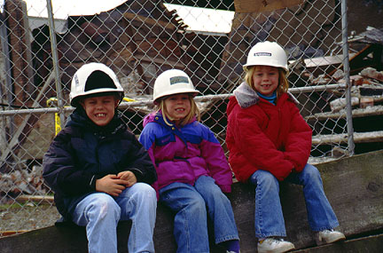
Photo: Dave Swanson

Slide 22
Summary
Have equipment, tools and safety items available.
Work your way to high volume/high priority bridges first. Know your lifelines.
Conduct inspections in your area ASAP after seismic event – inspect all 10 bridge components.
Document findings on paper forms and report bridges inspected and damage found.
Close damaged and failed bridges to protect the public – report closures.
Practice personal and public safety.

Slide 23
Family Protection Plan

Slide 24
Self and Family Plan
“An employee that is overly concerned about his or her family is darn near worthless. The investment in dealing with this concern pays big dividends in the long run. Of course, pre-earthquake planning at home can prove to be invaluable for all concerned.”
(Richard J. Evans, San Francisco Fire Chief, October 17, 1989)

Slide 25
Self and Family Plan
Am I really prepared?
What’s there to worry about?
How bad could it be?
What can I do?

Slide 26
Self and Family Plan
STEP 1: Find out which disasters you may experience where you live.
STEP 2: Create a plan with your family.
STEP 3: Put your plan into action.
STEP 4: Practice and maintain your plan.

Slide 27
Self and Family Plan
ACT NOW!!!
IF YOU FAIL TO DO SOMETHING IN
THE NEXT 24 HOURS - YOU WILL
PROBABLY DO NOTHING AT ALL!!!
Thank You

Slide 28
11. Finishing up
Any questions?
X
2.
1.
2.
3.
2.
4.
3.
5.
6.
2.
1.
7.
6.
10.
5.
4.
11. Inspect same components on other end of bridge
8.
9.

